Slide 1


Slide 2
Efficient Halo Exchange For Stencil-Based Scientific Codes on Cerebras Wafer-Scale Engine
Amartya Yadav
MSc. HPC from EPCC, University of Edinburgh
Developed at Edinburgh Parallel Computing Centre (EPCC), University of Edinburgh

Slide 3
About Me and My Work with Cerebras WSE
Completed my MSc in HPC from EPCC, University of Edinburgh.
Research interests in Computational Physics, Wafer-Scale Computing and Accelerators
As part of my MSc dissertation project, I implemented a Lattice-Boltzmann method solver for Computational Fluid Dynamics on WSE-3.
The LBM algorithm involves:
Halo Exchange
Streaming – stencil op.
Collision – stencil op.
Implemented Halo Exchange using two approaches. Gave me deep insights and experience on the arch. and CSL.

Slide 4
Before everything else, please…
We need to set up WSL (Windows Subsystem for Linux) on the machines in front of you with Ubuntu 24.04 as the distro
Open Terminal
wsl.exe –install
Wait for that to finish, and then restart the system.
After the restart, open Terminal again
wsl.exe –-install Ubuntu-24.04 Wait for this to finish.
When prompter, set up a user with password:
user: sci25 password: pass@123
Once this is done, you should be inside the WSL terminal.
Now Install VS Code on your Windows machine (might take long)
Also install the Cerebras SDK (as it is a big download and might take time).

Slide 5
Outline
Cerebras WSE-3 Architecture
WSE Programming
Halo-Exchange
Checkerboard Pattern of Communication
Implementing a simple halo-exchange in CSL

Slide 6
Dataflow Model, Cerebras WSE and WSE architecture

Slide 7
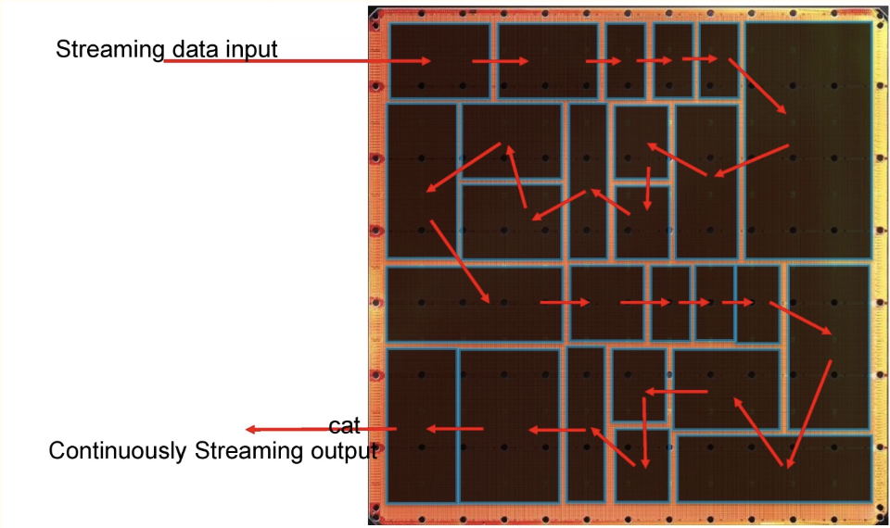
Dataflow Model
"Dataflow machines are programmable computers of which the hardware is optimized for fine-grain data-driven parallel computation.”¹
Characterised by spatial parallelism
Tens of thousands of processors
Fast on-chip network between processors
Generally, lacks centralised memory
Usually power efficient
1 https://dl.acm.org/doi/10.1145/27633.28055

Slide 8
Wafer Scale Engine (WSE)
Made by Cerebras
Built upon a 5nm process technology
The current generation WSE-3 specs:
900,000 independent cores
44GB on-chip SRAM memory
21PB/s aggregate memory bandwidth
214 Pb/s processor to processor fabric bandwidth
The flexibility of the independent cores and the large amount of memory means that, the WSE-3 is capable of delivering the performance of many GPUs

Slide 9
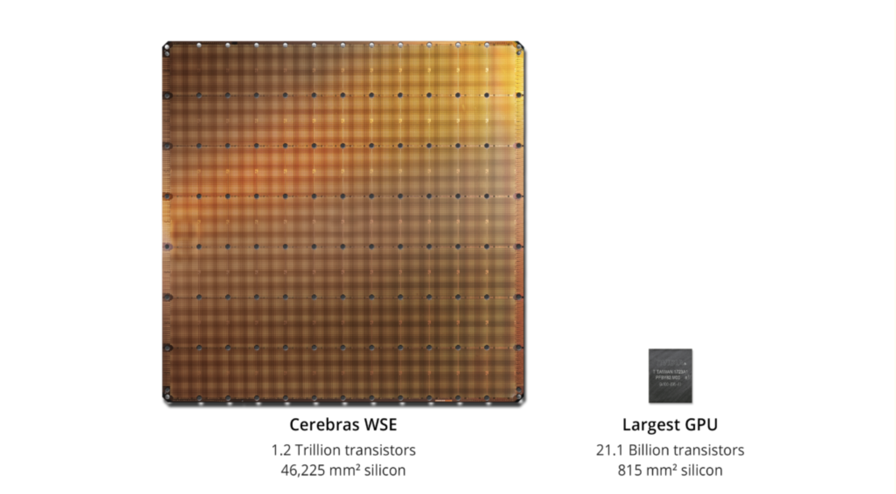
Cerebras WSE-3 vs Largest GPU

Slide 10
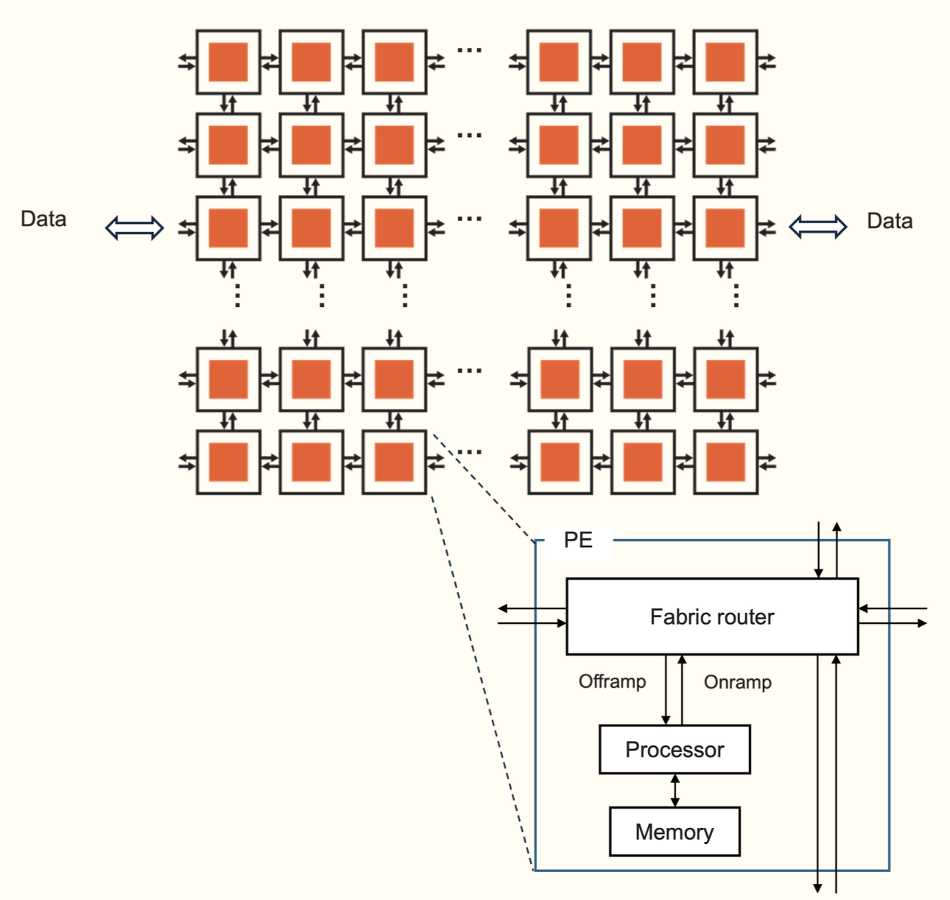
WSE PE Details
The processor itself
Commonly referred to as the Compute Engine (CE)
Independent and private from any other
A router
Connected with bidirectional links to own CE and router of four neighbours
Link to own CE is called the RAMP and neighbours are referred to by north, south, east and west
This is the only way in which PEs can communicate
Local (private) memory
All data and code for the PE is stored in this memory
48KB per PE

Slide 11
WSE Programming

Slide 12

Programming the WSE
For machine learning – PyTorch (not what we are doing today)
The original and primary workload
For everything else - Cerebras Software Language (CSL)
Based on the Zig language
Host CPU(s): Python
Loads program onto CSX system
Streams in/out data from/to device
Launches device functions
Device: CSL
CSL programs run on groups of cores on the WSE, specified by programmer
Executes dataflow programs

Slide 13
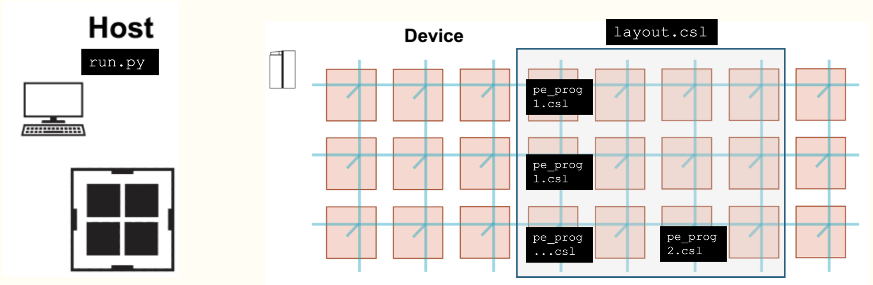
The Components of a Program

Slide 14
Programming the WSE - communication
A wavelet is a 32-bit message communicated with a neighbour in a single cycle
Each physical channel has 24 virtual communication channels known as colors that can be used for passing wavelets
Each wavelet has associated with it a 5-bit identifier which defines which channel it is communicated on
Determines the wavelet’s routing through the fabric and its consumption
This is a bit like a tag in MPI point-to-point communications

Slide 15
Data Structaure Descriptors
Think of it like MPI Derived Datatypes – essentially an array and an access pattern represented together in a single structure.
Useful because adding two arrays (elementwise using a loop) is inefficient as compared to a ‘DSD add operation’ which is done on the entire tensor, which is h/w and compiler optimised. And other type -
Two types of DSDs –
Memory DSD -> used to perform operations on a tensor as aforementioned
Fabric DSD -> used to receive and send wavelets using fabout_dsd and fabin_dsd to the fabric along a color.

Slide 16
Halo Exchange

Slide 17
Halo Exchange - briefly
Halo exchange is the communication of boundary data between neighbouring subdomains in a decomposed computational grid.
Ensures each process has up-to-date values in its ghost/halo cells required for stencil computations.
Typically involves point-to-point communication (e.g., MPI send/recv).
Critical for maintaining data consistency, accuracy, and scalability across distributed memory systems (yes, WSE is like a dist. memory system – loosely speaking).

Slide 18
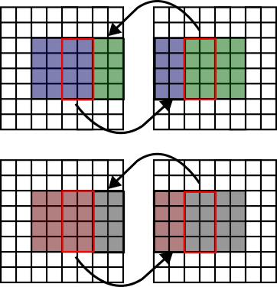
Halo Exchange - visualised

Slide 19
Halo Exchange - continued
Usually simple enough to perform the p2p communication required to send the data b/w computing nodes in a traditional cluster or processor.
Gets tricky in WSE – "we cannot safely send and receive multiple wavelets on the same color with a fixed routing”¹
Result – we need to use a checkerboard communication pattern between the PEs.
Checkerboard pattern ---- extremely complicated layout.csl file.
1 https://sdk.cerebras.net/csl/code-examples/tutorial-gemv-08-routes-3

Slide 20
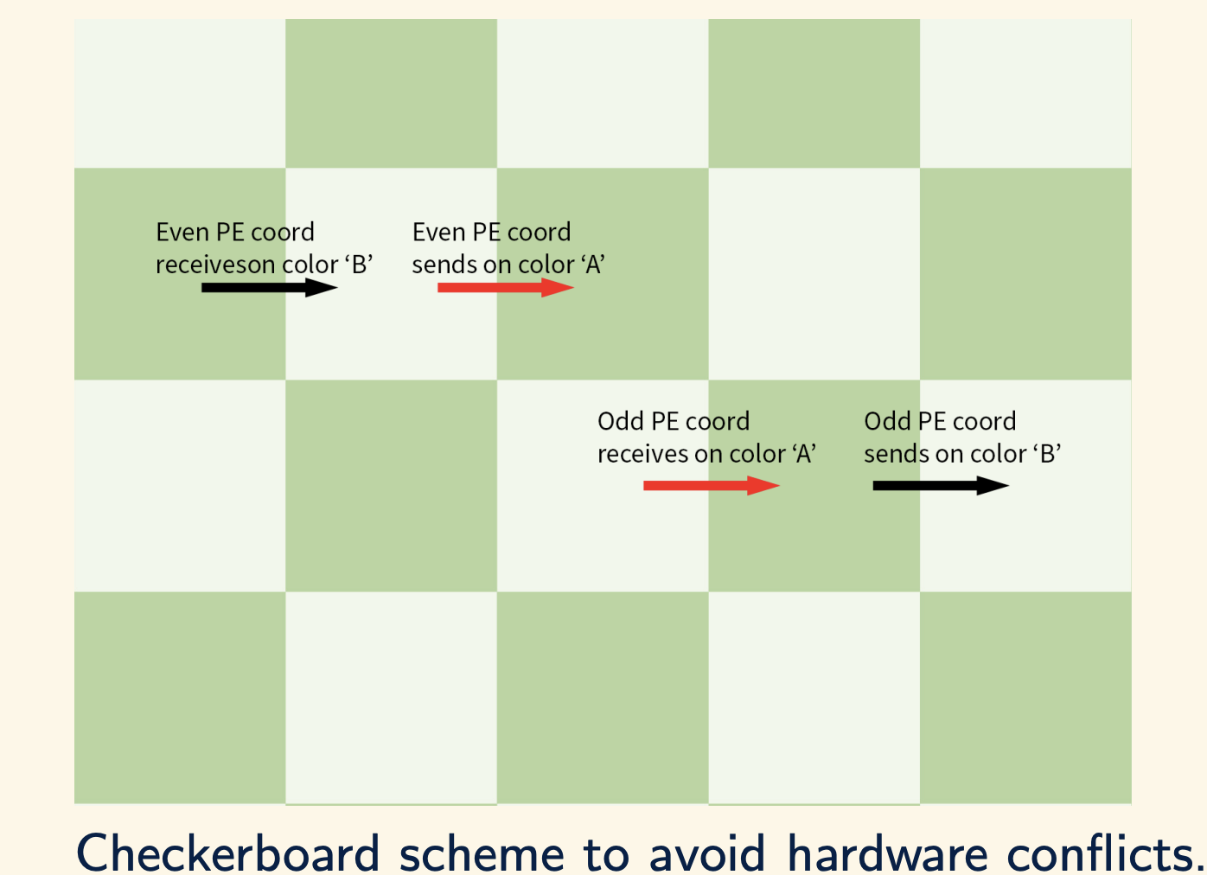
Checkerboard Comm. Model
Each PE has a coordinate (0,0), (1,0), (3,1) etc.
Need to use different colors for sending/receiving to/from a direction for a PE.
Even PEs (0+0=0 - even)
Odd PEs (2+1=3 - odd)
Looks simple enough as a concept here diagrammatically, but in code…
1 https://sdk.cerebras.net/csl/code-examples/tutorial-gemv-08-routes-3

Slide 21
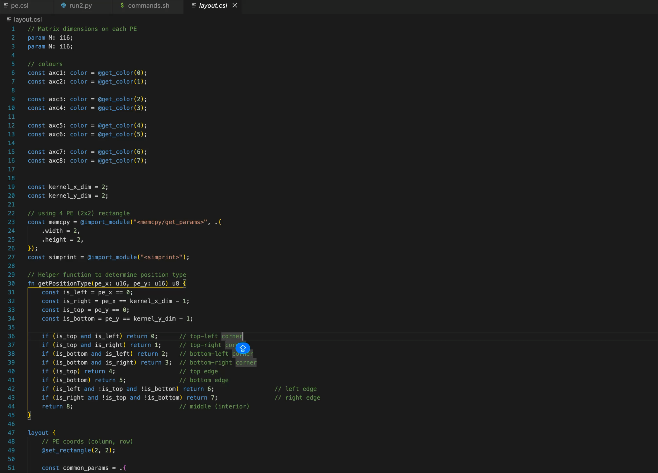
THE LAYOUT.CSL FILE FOR CHECKERBOARD PATTERN
1 https://sdk.cerebras.net/csl/code-examples/tutorial-gemv-08-routes-3

Slide 22
Setting up the Cerebras SDK and simulator

Slide 23
Cerebras WSE Simulator
CS-X machines are designed to be exclusive use
Routinely developing code directly on the CSX would be a big pain, due to contending with lots of other users at the same time!
Machine start-up time is not trivial. Almost no debugging available.
Cerebras also provide a software simulator of the CS-X
Simulates execution of your program by running it on the CPU
This is generally very accurate and should be used during development to test your code
Provides debugging tools (log files with various information, print statements, GUI (currently does not work for WSE-3 arch. – known issue))
Can be limited in accuracy and range (scale) of programs being run due to system resource limitations
Also, we do not have access to an actual Cerebras CS-3 machine to run the code on.
Available at some labs around the world – EPCC has one.

Slide 24
Access the Repository and SDK
Clone the repository from: https://github.com/amartyadav/SCI2025_CerebrasWSE_HaloEx
Download the Cerebras SDK from this link (also present in the repo inside SDK_Link.txt): https://www.dropbox.com/scl/fi/2lgy7q7rwg366wf9m9r1l/Cerebras-SDK-1.4.0-202505230211-4-d9070058.tar.gz?rlkey=fk8egs6dop9n3prrgnmz5ji6u&st=fx1rehni&dl=0
IMPORTANT: Remember, by using this link to download the SDK, you agree to the End User License Agreement provided by Cerebras, which can be found in the SDK directory. This is an official link, and not my copy of the SDK. This has been given by Dr. Leighton Wilson, Senior MTS @ Cerebras, upon request, especially for this tutorial. The other official way to access it is using the SDK Request form at the Cerebras Website. This link has been provided for your convenience in this tutorial.
It is very important that you do not share the SDK (or any access to it using the link) without permission from Dr. Leighton Wilson/Cerebras directly.
1 https://sdk.cerebras.net/csl/code-examples/tutorial-gemv-08-routes-3

Slide 25
Linux SDK Setup
In the repo, follow the instructions to set-up the SDK and Apptainer on your Linux machine.
This can be found in SDK_Setup_Linux.rtf
Very straightforward to get it working on Linux
1 https://sdk.cerebras.net/csl/code-examples/tutorial-gemv-08-routes-3

Slide 26
macOS (Apple Silicon) SDK Setup
In the repo, follow the instructions to set-up the SDK, Lima on your Apple Silicon macOS machine.
This can be found in SDK_Setup_macOS.rtf
Slightly more complex to set it up on an Apple Silicon macOS machine.
Points to be noted:
Apple Silicon is an ARM arch. processor. The SDK specifically requires x86 arch.
This is why we make a Lima x86 Linux (Ubuntu) VM and install the SDK and simulator there.
Emulation bugs while using the simulator are possible since we are emulating x86 on ARM. This can lead to unexpected results in rare cases. Usually works flawlessly.
Is considerably slower as compared to running on x86 platform on Linux. Noticeable when compiling and also when running the code.
1 https://sdk.cerebras.net/csl/code-examples/tutorial-gemv-08-routes-3

Slide 27
Windows (WSL) SDK Setup
Running the SDK on Windows using WSL (Windows Subsystem for Linux) has not been tested recently. It has been known to work, and was used primarily for developing my research code.
This was 6 months ago. Not been tested recently.
It might still work, or could fail due to external factors.
If you are using a Windows machine, it is worthwhile to try the SDK+Simulator on WSL. Instructions are exactly the same as for Linux, but to be followed in the WSL environment.
Not possible to run without WSL (directly in Windows). Also not tested for ARM windows machines.
1 https://sdk.cerebras.net/csl/code-examples/tutorial-gemv-08-routes-3

Slide 28
Implementing the Halo Exchange on WSE-3 (Coding)

Slide 29
Instructions
The directory Tutorial_Code has the exercise code for you to work on. It has all the instructions as comments, and some portion of the code has been done. It has been structured as a lab/exercise – easy enough to follow using the examples given in the code, but challenging enough to make you think.
I will explain what needs to be done as well, while we go through the code in depth.
If you get stuck, refer to the complete solution in the Reference_Code_Complete directory. Some variable names might be different along with other minor differences.

Slide 30
layout.csl
Will set up a 2x2 grid of PEs for computation, to keep things simple to understand and visualise.
Will define colors and route configs. for each PE
This will be done following the checkerboard pattern discussed previously

Slide 31
layout.csl – non-periodic boundary
We will set up a non-periodic boundary communication pattern
This means that the top-left PE will only exchange with the east and south neighbours, bottom right PE will only exchange with the west and north neighbours etc.
0,0
1,0
2,0
3,0
0,1
1,1
2,1
3,1
0,2
1,2
2,2
3,2
0,3
1,3
2,3
3,3

Slide 32
pe.csl
The actual halo exchange logic - includes:
Initialising the grid to be exchanged (each PE generates a unique grid based on their coordinates – easy to check correctness and debug the exchange)
Setting up input+output queues (for the send/recv operations) to be used with the colors that we defined in the layout.csl file. Refer to Appendix A for details.
Need to set up ‘Microthreads’ – extremely important as we will do as much as 8 send/recv. operations from the interior PEs, but we have limited I/O queues. Think of it as boilerplate for this tutorial. Already included in the code. Refer to Appendix B for details.
Will set up ‘Tasks’ – like functions, but cannot be called. Only activated either manually or automatically on receiving an incoming wavelet. Can also be blocked/unblocked. Refer to Appendix C for details.
Will set up ‘DSDs’ – both - memory and fabric. Memory DSDs to ‘pack’ the edge columns and rows for exchange. Fabric DSDs to send/recv. Refer to Appendix D for details.

Slide 33
Host code (run.py)
Host code is written in Python.
Already included a lot of set-up/boilerplate code to get stuff working.
Main part:
Launch the kernel
Copy the final grids after the halo-exchange back to the host
Print the grids in a file to see successful exchange

Slide 34
Congratulations!
In this tutorial, you (hopefully!):
Learnt the architecture (H/W) of a brand-new and possibly revolutionary accelerator – Cerebras WSE-3
Learnt the programming model of the WSE-3.
Got introduced to and programmed in a new (and not so easy) language – Cerebras Software Language
Learnt a new way of communication (apart from CUDA calls and MPI) for parallel programming
Implemented a rather complex code on a complex accelerator – Halo Exchange on WSE-3.
Can serve as a starting point for a lot of scientific codes which require stencil computations (or just any computation involving communication between PEs)
Have your own working copy of the Cerebras SDK and Simulator to experiment as much as you want.
You now belong to a small club of people who are comfortable with Wafer-Scale computing with WSE-3+CSL !

Slide 35
Feel free to get in touch
Feel free to get in touch for any guidance, doubts, or clarity regarding Wafer-Scale computing, Cerebras WSE-3, parallel programming with WSE-3 or anything else.
Catch me in the conference until the 13th of Dec.
For future contact (for anything at all):
amartyadav[at]gmail[dot]com
https://amartyadav.com – general updates about me, my work and my blogs.

Slide 36
THANK YOU

